Slide 1
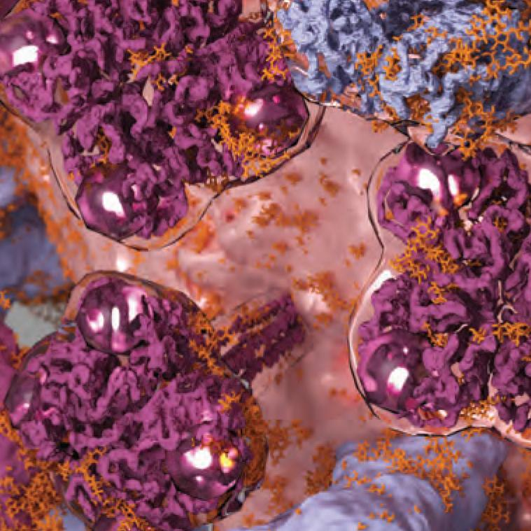
ProteinVR, YogAlex and Computational Chemistry
Yogindra Raghav, Alexander Chang
Notes:
Introduction to who we are and title (YOGI)

Slide 2
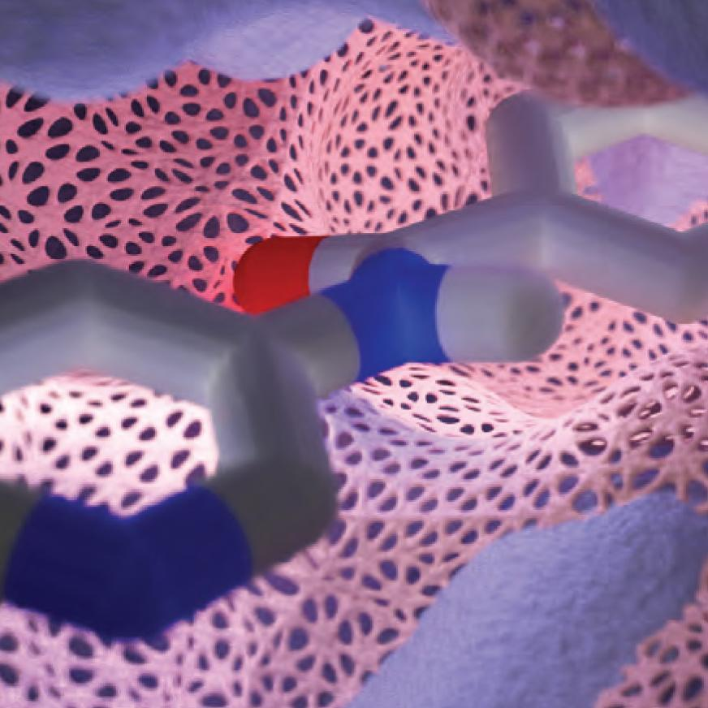



Research and Technologies
Purpose: innovating science education
Principal Investigator: Dr. Jacob D. Durrant
Python, Blender, Ubuntu
Notes:
Need to explain exactly what the goal is for ProteinVR/Yogalex. Why is it necessary for the community? (To stimulate interest and learning within students, and to give other options for students for learning)
No need to act as Yogalex and ProteinVR are still two different projects, just treat it as one project (Point 2 is not really needed)
Give overview of what ProteinVR exactly is (YOGI)
Explain how YogAlex ties into it. (ALEX)
DO NOT EXPLAIN COMPUTATIONAL CHEMISTRY PROJECT YET! (ALEX)
Mention who Dr. Durrant is briefly and the work he does(ALEX)
Explain the technologies (ALEX)

Slide 3
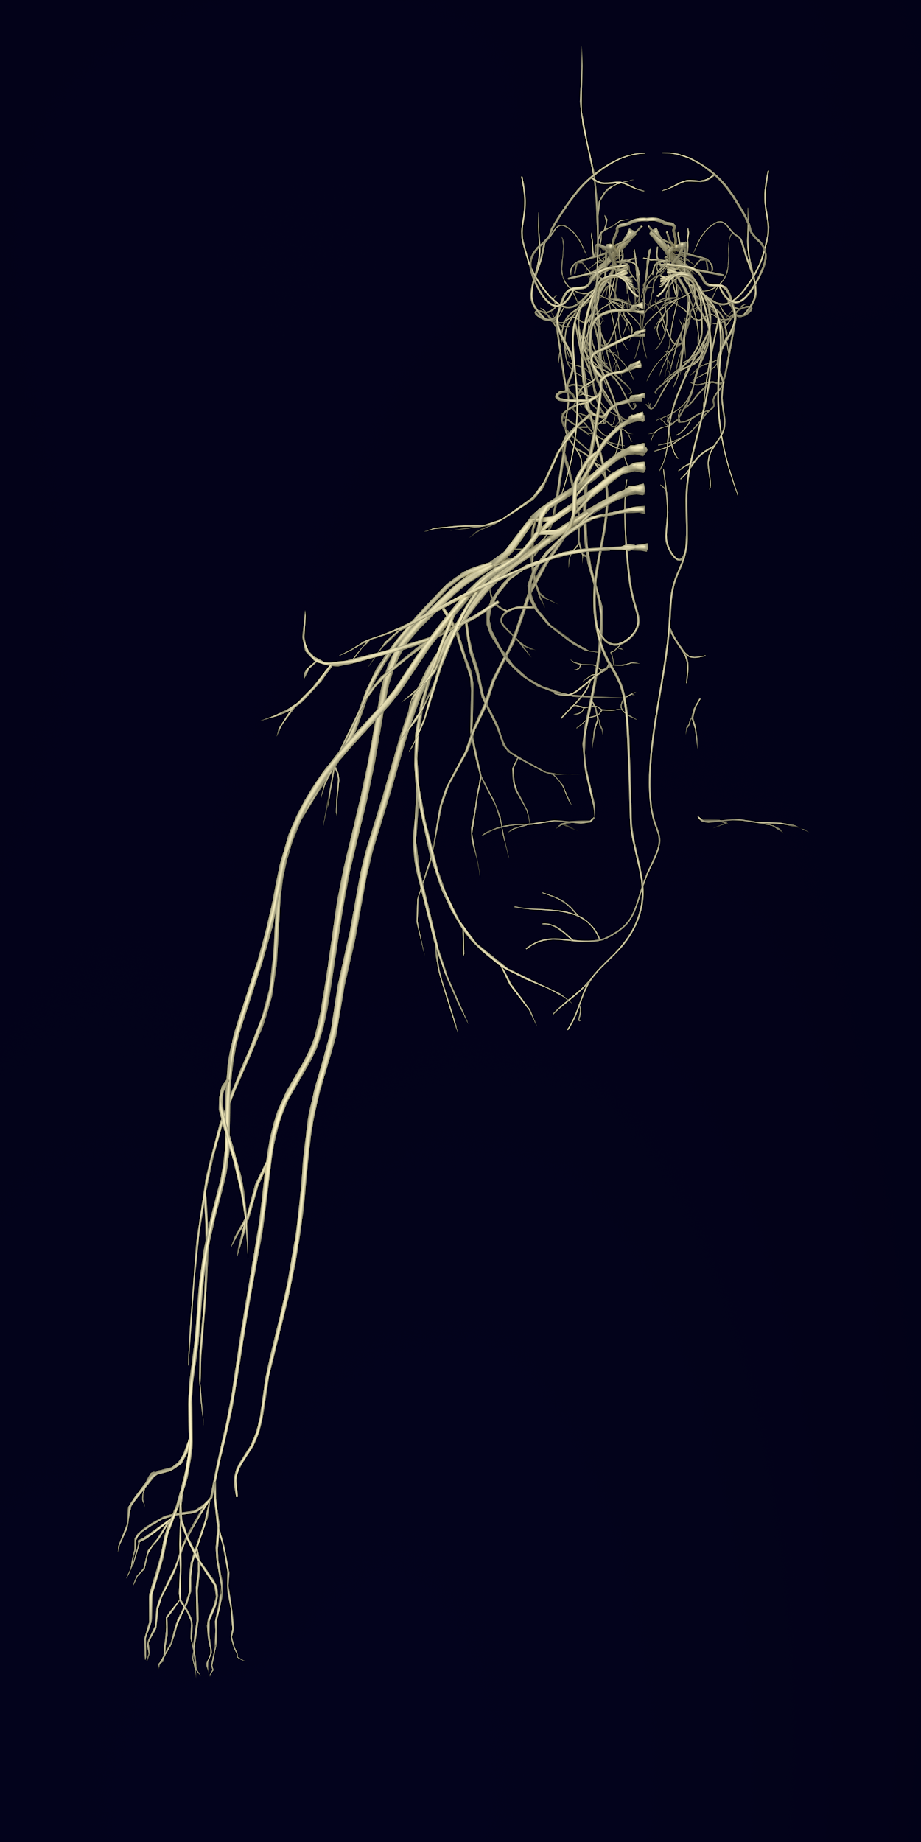
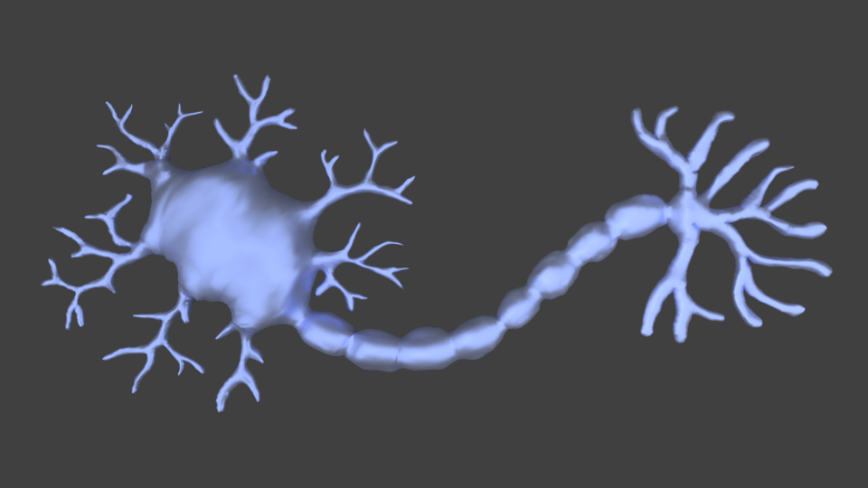
Blender Renders
Notes:
The process of making these renders involved: (YOGI) (ALEX : GO THROUGH SLIDES SLOWLY AS I EXPLAIN PROCESS)
Loading thousands of files using Blender Python scripts
Decimating each object using Blender Python
Using lighting/photography techniques such as 3-point lighting and contrasting backgrounds
Creating VR-compatible cameras
Using the Blender node-setup to mix different materials to achieve a realistic look

Slide 4
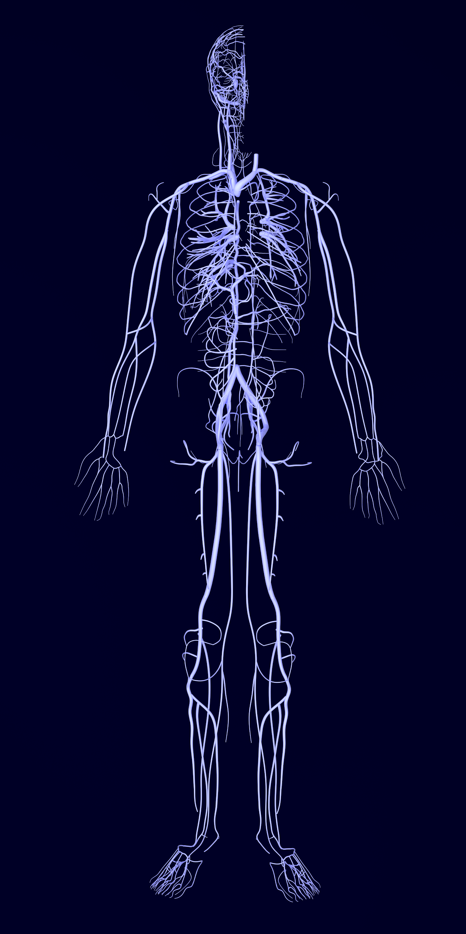
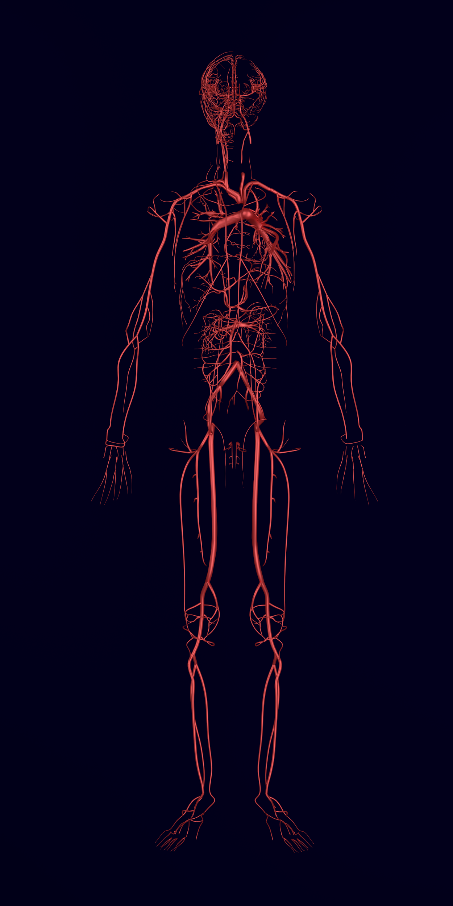

Slide 5
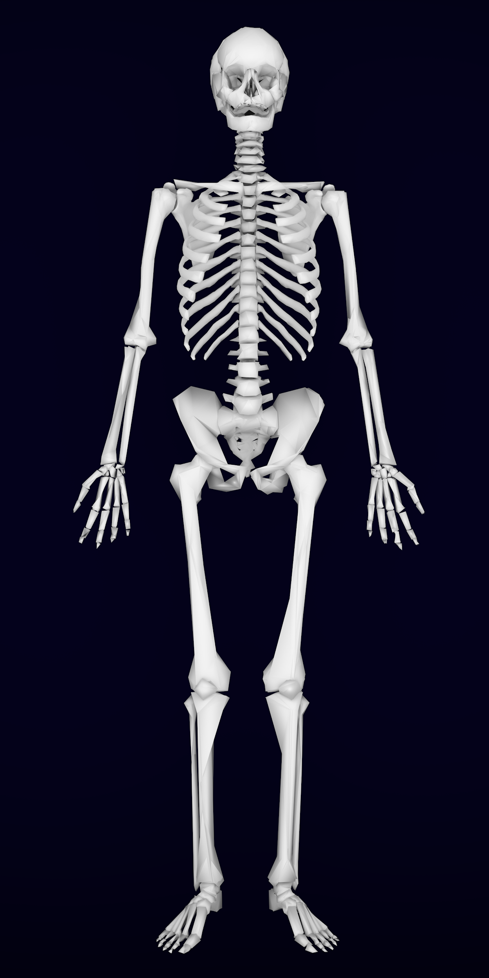
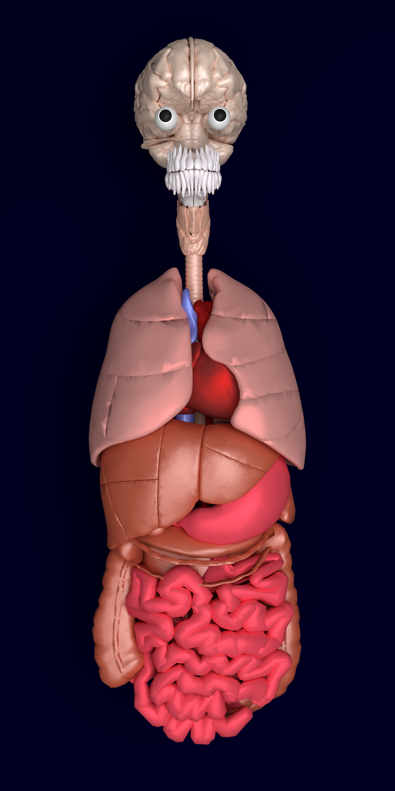

Slide 6
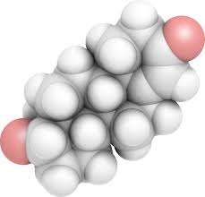
DEMO TIME!
durrantlab.bio.pitt.edu/tmp/proteinvr
TURN OFF YOUR VOLUME! (Unless you have headphones)
Choose any scene
Laptop -----> Hardware = “Screen”
Phone ------> Hardware = “VR Headset”
Notes:
Time to demo! (ALEX: DON’T FORGET TO MENTION THE LAST POINT “5.”)
GO to website
Choose any Scene
REMIND THEM TO TURN OFF VOLUME!
If you choose “VR Headset” and are not wearing one, you will notice that there are two screens! THIS IS INTENTIONAL! It works when you have the headset on to give illusion of 3D.
IT IS STILL BUGGY. We know this. We are working on fixing rendering issues, changing backgrounds of scenes, and adding voice over to give a more ROBUST experience.

Slide 7
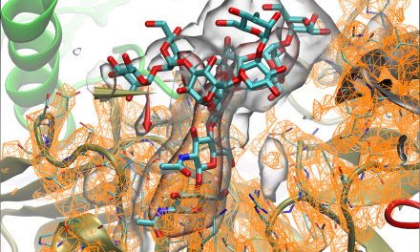
SCREEN DEMO TIME!
Scene 7
Scene 8
New Insulin Receptor
Notes:
These are the scenes to show (YOGI)
(ALEX: OPEN THE FILES AND DO THE DEMO. JUST FOLLOW WHAT I SAY WHEN I SAY TO SWITCH IT)

Slide 8

TIME TO SWITCH IT UP!
ProteinVR & YogAlex on Hold
Time to delve into ChemoInformatics/ Computational Chemistry!
Throw a healthy dose of machine learning into equation…
Notes:
Explain why Protein-VR is on hold (aka. Dr. durrant wants to publish proteinvr and yogalex together and so we had to move projects) (ALEX)
Explain Machine Learning. EXPLANATION: We hope to use a multi-variate regression model for machine learning to help with drug discovery. It does so by predicting whether a given small molecule ligand can bind to a target protein and the likelihood of such an event happening. The “multi-variate” part of the model is that we need to create lots of different “features” aka predictors to regress with. This is where Computational Chemistry gets involved. (YOGI)

Slide 9
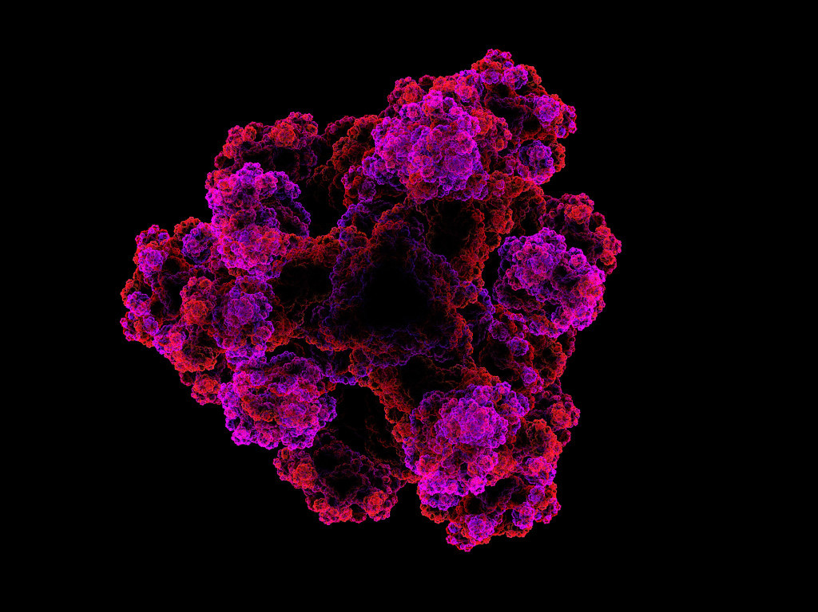
Computational Chemistry Software
NNScore 1.0, 2.0
Scoria
RDKit
AutoDock Vina
Notes:
MENTION THAT ALL THESE SOFTWARES ARE OPEN-SOURCE!!!
NNScore 1.0 and 2.0 are both computational chemistry softwares that accept a small molecule ligand and a receptor protein and use convolutional neural networks to predict the binding favorability of the inputs. This is useful in our current project since there is lots of code that generates many of our features that will be fed into our multivariate machine learning model (ALEX)
Scoria- software a python module for importing, manipulating, and exporting multiple molecular models. (ALEX)
RDKit- software that takes a given molecule and can return lots of useful information! The useful information we care about is descriptors for machine learning (example. Distance between a ligand carbon to the receptor carbon) (YOGI)
AutoDock Vina- software called by NNScore, which gives relatively accurate predictions of a ligand binding to a receptor molecule, Also use autodock conventions to describe different molecule interactions (YOGI)

Slide 10
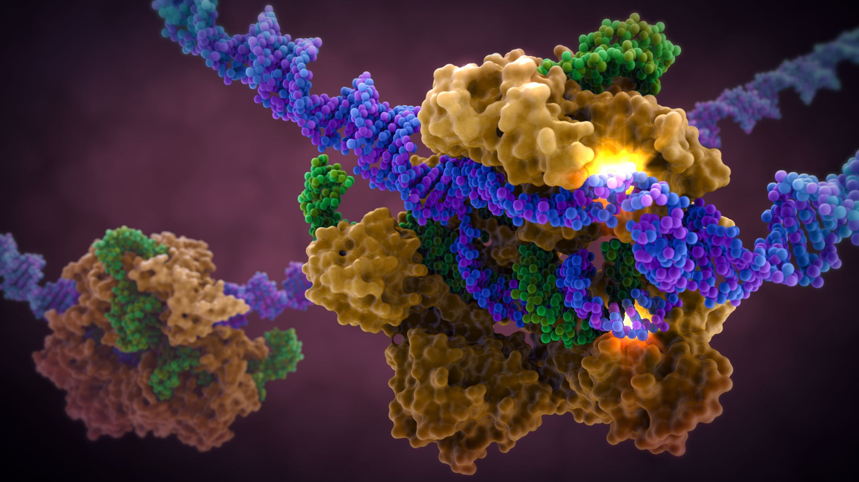
Questions? Comments?

